Slide 1
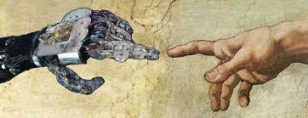
Relational artificial agents
CT5142 Ethics and AI

Slide 2
Content
Ascribing intentionality to artificial agents
Interaction with artificial agents

Slide 3
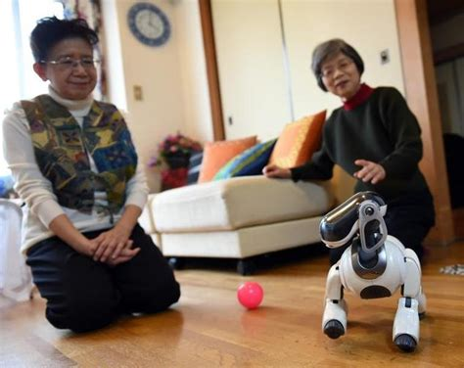
Ascribing intentionality to artificial agents

Slide 4

Ascription of intentionality
Humans hardwired to ascribe intentionality to objects if they show any type of activity that can be interpreted as being goal directed or expressing emotion
https://www.youtube.com/watch?v=n9TWwG4SFWQ

Slide 5

Human willingness to engage with artificial agents
Eliza – a basic automated counselling programme (Weizenbaum 1966)
Digital pets and toy robots (starting with Tamagotchis, Furbies and AIBOs) – „alive in a Furby kind of way“
Care robots (from PARO to NAO and Pepper)
Personal digital assistants (Siri and Alexa)
Chatbots in customer service contexts

Slide 6

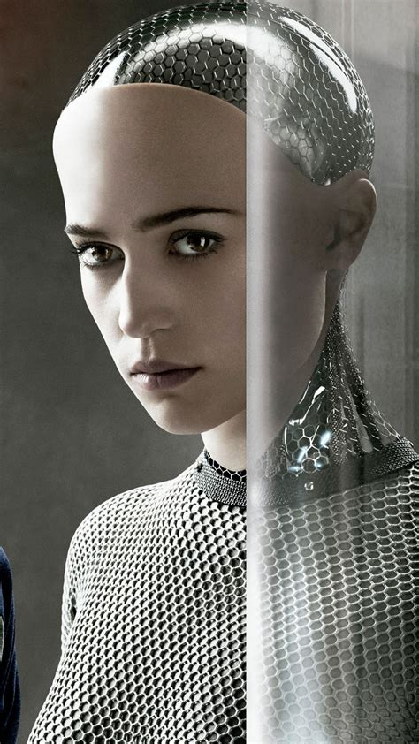

Fascination with artificial agents

Slide 7

The Turing Test
Proposed by Turing (1950) as criterion for when machines have acquired sufficient intelligence to be comparable to humans
„imitation game“, i.e. not about consciousness but about passing as human
Natural extended conversation between human judge and either machine or other human; judge needs to identify whether interaction partner is human
Turing test as distraction? Other capacities may matter more…

Slide 8

Passing as human in everyday contexts
Scripted conversational agents can pass as human in normal non-test circumstances in the right conditions
Malicious flirtbots (from CyberLover 2007 to Tinderbots 2020)
Gilbert & Forney (2015) achieved 78% judgement as human for 3D avatars in SL during a guided tour through a shop in Second Life with unsuspecting participants
Burden et al. (2016) achieved 100% judgment as human for chatbot in student online PBL learning group (although oddness was identified post hoc)
Willing to discount communication peculiarities if contextual clues support interpretation as human, e.g. visual appearance as human, emotional expressiveness, possibility of non-native speaker, acceptability of limited conversational range in specific context

Slide 9
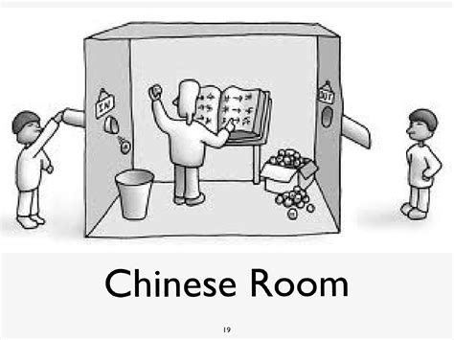
Artificial consciousness and singularity
Will increase in abilities of AI lead to AI developing consciousness?
What evidence would be needed to distinguish AI consciousness from merely simulating human behaviour? (Searle‘s Chinese Room)
If AI developed consciousness, would it be like our consciousness, or would it be categorically different, and in what respects? (see Ava in Ex Machina)
Will AI surpass us in intelligence and possibilities of independent agency, achieving superintelligence (so-called “singularity”)?
Given open questions, should we aim to create artificial intelligence that resembles human characteristics, or is that too risky?

Slide 10
Interaction with artificial agents

Slide 11

Sherry Turkle on interaction with AI and robots
Science and technology researcher interested in understanding relationships between humans and AI/Robots
“computational objects do not simply do things for us, but do things with us”
Book: “Alone Together” (2011) https://www.ted.com/talks/sherry_turkle_alone_together?language=en

Slide 12
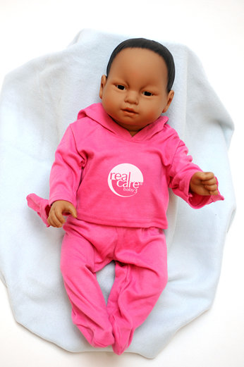
“Relational artefacts” and “liminal objects”
Social AI/robots are artefacts that were created to facilitate and engage in social relationships
Social AI/robots are liminal objects between machines understood as objects and interactive partners with whom we have a social relationship
Research shows that we easily engage emotionally with fairly primitive robots or AI, and struggle with anthropomorphisation
Notes:
E.g. research on children with Furbo and Tamagochis, older persons with robotic dolls

Slide 13
Example: Care robots
A robot that has been developed to contribute to care in domestic, hospital or other care settings (Vallor, 2011)
Roles: Assistence, Surveillance, Companionship
Prominent especially in care of older persons and children with autism
Solution to demographic problem of increase in number of older persons and reduction of number of available carers
Advantage: available around the clock, lower costs, can compensate deficits in everyday life, delay onset of institutional care
Notes:
Specific functions: e.g. lifting, bathing, feeding, health monitoring, reminders, activation, entertainment, emotional engagement

Slide 14
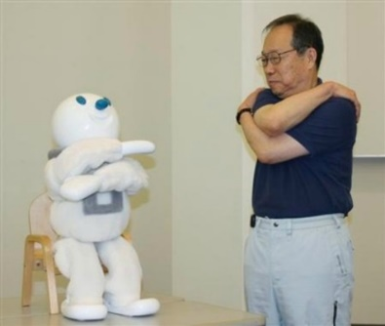
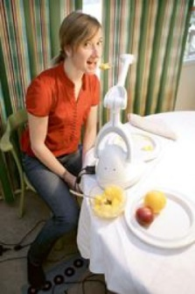
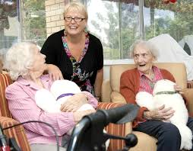
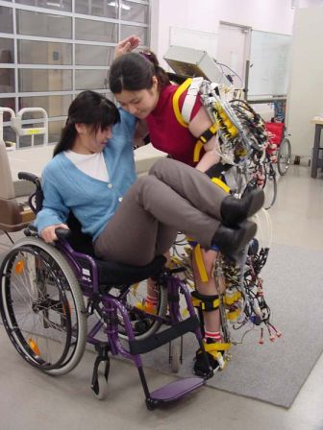
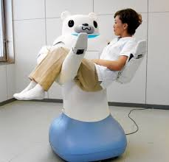
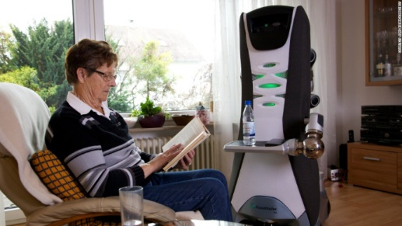
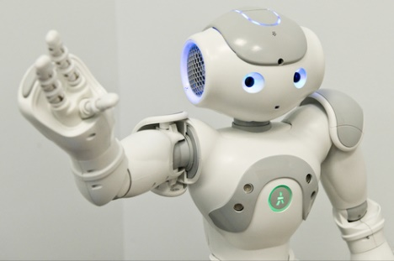
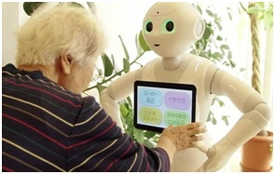
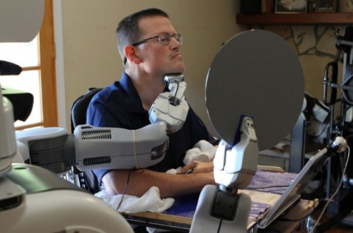
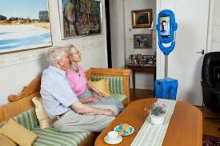
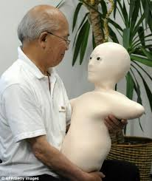


Some care robots

Slide 15
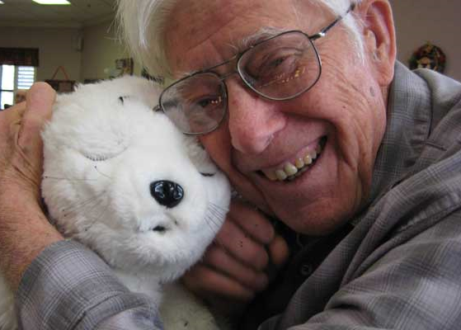
Companion robot for dementia
PARO is soft and fluffy to the touch, reacts to touch, voices, and expressions of attention
Used especially for persons with advanced dementia
Supports emotional interaction for persons for whom interpersonal contact is frequently too confusing or demanding

Slide 16

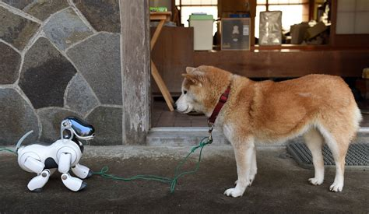
Domestic companion robots
AIBO robots were one of the first popular complex zoomorphic companion robots
Very popular in Japan
Domestic companion for many older persons in Japan, rather than live pet
Significant attachment, e.g. funeral rites once not repairable any more (production and support ceased)

Slide 17
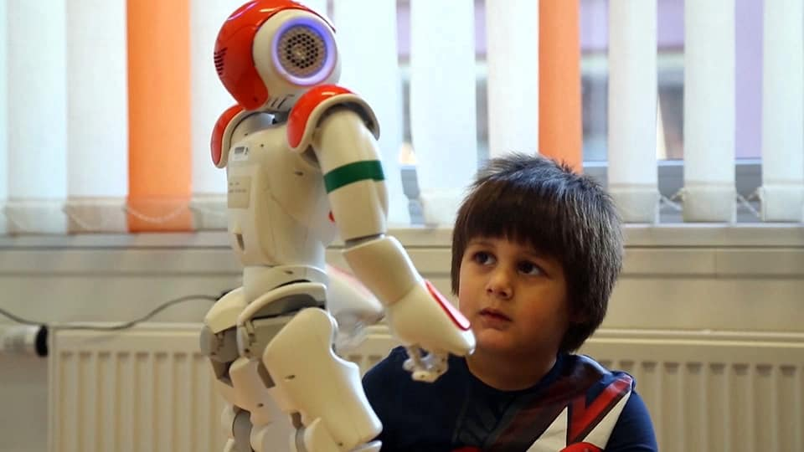
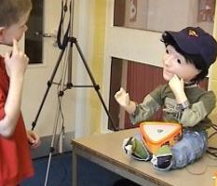
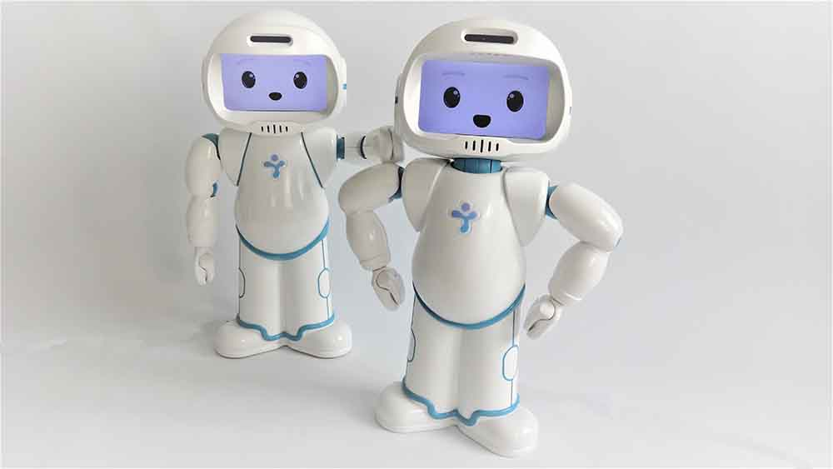
Eductional robots for children with autism
Social robots for training social skills of children with autism
Children with autism generally seem to enjoy working and learning with robots
Recognition of emotional expression, physical activity, movement repetition, learning of numbers and letters

Slide 18
Ethical risks in using care robots (Sharkey & Sharkey 2012)
(1) reduction in human contact
(2) objectification and loss of control
(3) a loss of privacy
(4) a loss of personal liberty
(5) deception and infantilisation
(6) Who controls the robot
Notes:
Grenzen dessen, was der Nutzer dem Roboter vorschreiben kann – „Imperativ der Gesundheit“ R&Frank oder Big Hero 6

Slide 19
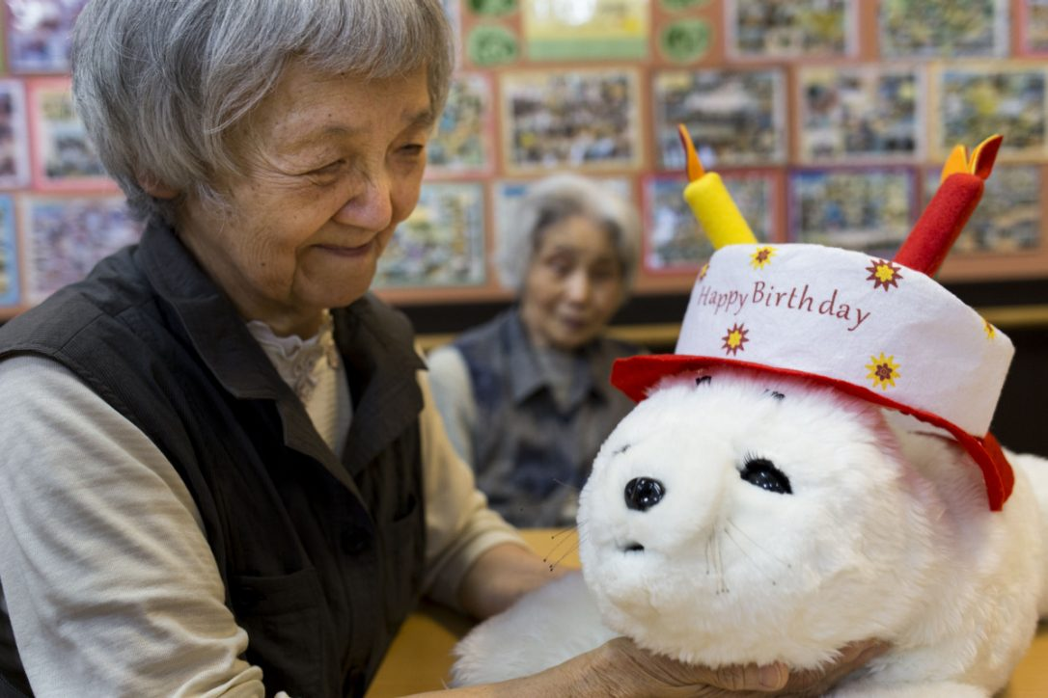
Replacing human relationships with AI/robots?
Reducing opportunity of genuine human interaction – especially problematic for applications for vulnerable persons
Danger of deceiving users into believing the AI/robot has deeper interpersonal capacity than it does and is engaging in a “real” relationship with them
Question whether interaction with robots deprives persons of genuine human interaction and this constitutes a harm, even if they don’t seem to mind

Slide 20
Consumer chatbots
Increasing use of AI powered chatbots, with speech recognition and natural language processing
Highly scaleable
market size expanding quickly, from $250 million in 2017 predicted $1.34 billion in 2024
Increasing ability to come across convincingly as human
However, frequently rejection by consumers
Consumers prefer knowing they are talking to a human, and engage more emotionally if they think they are talking to another human

Slide 21
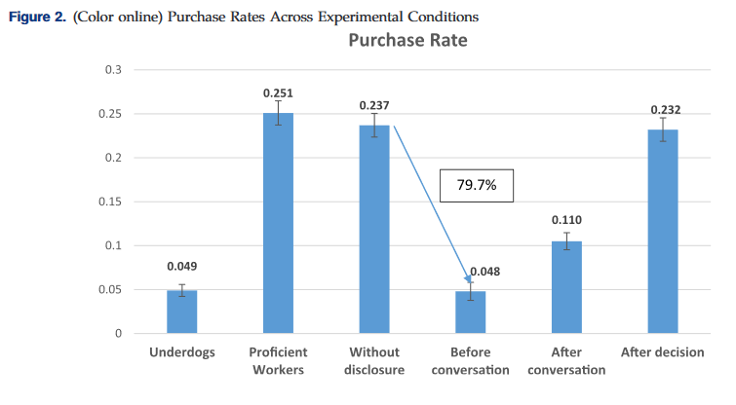
Algorithm aversion: Impact of chatbot use on purchases (Luo et al. 2019)
randomised 6,200 customers to highly structured voice chatbot or human worker sales call
Undisclosed chatbots as effective as proficient human workers, 4 times more effective than inexperienced workers – but if chatbot nature disclosed at beginning of call, then purchase rate dropped by nearly 80%, if disclosed after conversation but before purchase higher purchase rate, but half of post-purchase disclosure rate
Prior AI assistant experience reduces negative effect

Slide 22
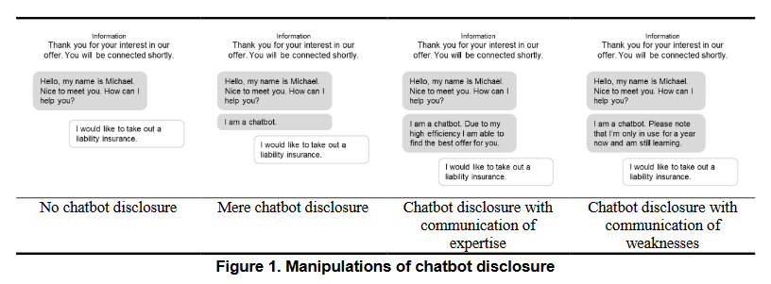
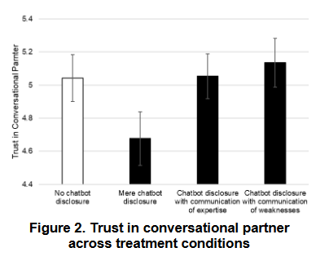
Increasing trust in chatbots (Mozafari et al. 2021)

Slide 23
Collaboration with artificial agents
Rather than replacing humans artificial agents have been proposed to be designed as collaborating alongside humans
Level of willingness to collaborate with artificial agents differs, e.g. depending on fear of replacement
Complex requirements for acceptable design and effective implementation (e.g. Cai et al. 2019 on diagnostic AI assistance for radiographers)
Awareness of complexity of relevant questions and unintended side effects (Seeber et al. 2020), e.g. deskilling of staff, dynamics of trust and dependence

